Slide 1


Today’s Agenda
9:30-9:45 – Service
9:45-9:55 – Introduction
9:55-10:00 – Passing to Breakout Rooms
10:00-10:30 – Breakout Exercise: Mission
10:30-10:35 – Return to Sanctuary
10:35-10:45 – Next Steps / Closing

Slide 2
Service Slides go here

Slide 3
LCR Visioning
Our Mission

Slide 4
Visioning Process Year 1:
Determine Our True North
Discovery Process: Survey, etc. (Completed)
This Summer
  Core Values
  Mission
Beginning September
  Vision
  Strategy
Notes:
Our Visioning is a 3 year process and we are in the first year. This year’s goal is to Align to Our True North. True North is: What direction do we want/need the church to go for future success? What is success? How will we make decisions to ensure we stay on course?
The 4 components of True North are: Core Values, Mission Statement, Vision and Strategy. And all 4 components must be aligned and work together to achieve success.
The key steps for determining Our True North are:
Discovery Process – We have completed this process. This was the Survey that the congregation completed, the demographic study and feedback from Racine area leaders.
This summer we are working on developing Our Core Values Statements and Mission Statement.
Then, Using the results from the Core Values and Mission Statement exercises, Develop Vision and Strategy (starting in September)
That’s the BIG PICTURE. Now, back to today and Our Core Values: Core Values are about where we are today: Our essence; Our identity, Why we’re here, what makes us unique. Core Values are our foundation
Upon which we build our future vision. Without true core values we cannot formulate a successful vision.

Slide 5
Our Mission
Small Group Breakout Exercise
Notes:
We’re ready to go to our breakout sessions. I’ll introduce the facilitators, their colors and you can follow them to your rooms with a brief stop in the narthex to be sure
IF you are a first time visitor to the church we invite you to stay and chat with pastor Karen about the church in __________
INTROS and places
DAWN – Choir Room
Tony – Sanctuary
Rachel – Youth Lounge
Leah – Family Room
Nicci – Fellowship Hall
Stacey –
Dave –
Myself Steve –
You will have 30 minutes to complete the exercise
Questions?

Slide 6
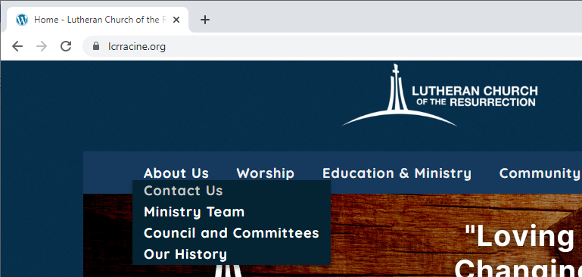
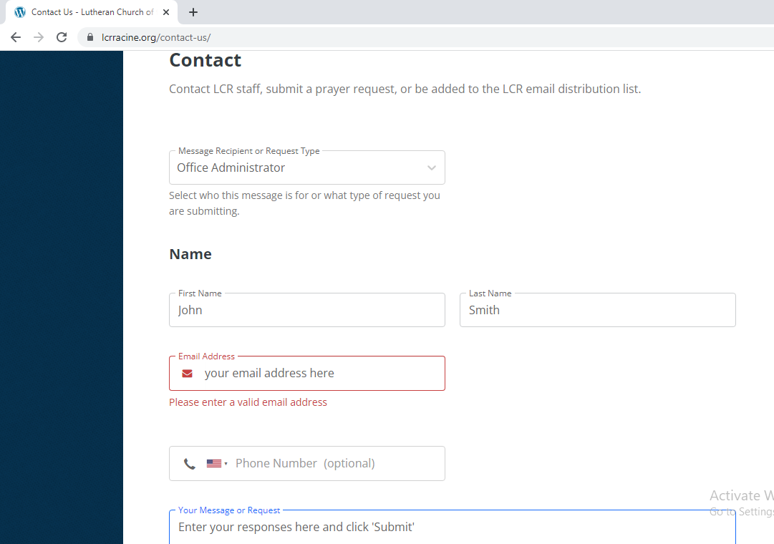
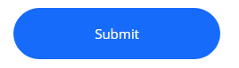
Online Viewers…
1
Send us your responses using the LCR website About Us, Contact Us request form
2
3
4
5
Notes:
For those of you watching online, please write down your responses during the session. Then after the service, go to the LCR website home page, LCRracine.org, About Us, Contact Us and complete the Contact form:
“Message Recipient or Request Type” select Office Administrator. Then
enter your name,
your email address, and
4) put your responses in the “Your Message or Request” field. When complete,
click the “Submit” button.

Slide 7
Our Mission
What is our Mission?
Why do we exist? What do we do better than others?
Who is our beneficiary? This is typically not “inside” the church. Who can we reach or serve better then others in our local community?
What is our objective or desired result? What difference would we like to see in 5 or 10 years?
State the mission. This could be a series of short phrases
Does it help us say no to good things? Help making the “hard” decision on how our resources will be used (volunteers, dollars, time, etc.)
TASK:
Develop our mission, keeping in mind the core values we identified in the last session.
Notes:
Steps:
Review Slide
Read Good Mission examples:
Starbucks: To inspire and nurture the human spirit – one person, one cup and one neighborhood at a time
Amazon: To be Earth’s most customer-centric company where people can find and discover anything they want to buy online.
Walmart: We help people save money so they can live better.
Review the Preliminary Core Value Summary list:
Welcoming, Community Service/generosity, Freely Accepting, Youth Support, Spiritual Accessibility/Variety, Openness, Willingness to change/evolve
Have group develop several mission phrases. Do not need to get to one only. Discussion how the points on the slide relate to each phase. What is missing?
TIPS:
Stay Neutral and Positive. Don’t Influence!
Encourage Participation:
“Tony, do you have any thought on this?”
“Mary, how do you feel about what has been said so far?”
Listen and ask clarifying questions:
“Tony, could you explain that a bit more?”
“Mary, did I document your idea as you expressed?”
Watch your time! Set a 10/10/5 minute warnings on your phone
Document all ideas and star the top 3-4

Slide 8
NEXT STEPS
The taskforce will combine all groups’ Mission statements into a list of the top 4-5 statements or ideas
Present to LCR’s Visioning Team for use in the next phase
Communicate back to the congregation on Sept 11th
Begin working on Strategy and Vision in September
Thank you for your thoughts and time!
Notes:
Next Steps and THANK YOU!

